Slide 1
STC – Force and Motion Kit
5th Grade EWIF Professional Development

Slide 2
Weather PD
Test content data
Questions
Concerns
Sharing of information

Slide 3
STC – Force and Motion: STEM bASED SCience
Addresses science standards
Engage in natural phenomena
Work with Tools of science
Solve real world problems
Work on technical design

Slide 4
Assessment integrated
Literacy (reading/writing/speaking/listening)
Mathematics
Extensions
Field trip suggestions
Visitor suggestions
activities
Pre/post assessment
Embedded assessment (formative)
Performance assessments
Self- assessment

Slide 5
Lesson 1 – science and engineering practices
Practice 1 Asking Questions and Defining Problems
Practice 2 Developing and Using Models
Practice 6 Constructing Explanations and Designing Solutions
Practice 8 Obtaining, Evaluating, and Communicating Information

Slide 6
Lesson 1 – Pre-assessment and Designing Vehicles
Think about:
what causes vehicles to move?
What do we know about motion the design of vehicles? – reflect
What doe we want to find out about motion and design?

Slide 7
Design challenge
In 20 minutes or less, design and build a vehicle that will move at least 100 cm.
How will you test your design?
How did you get your vehicle to move?
What was one problem your group encountered while building the vehicle?
Page 12 teacher manual

Slide 8
Educreations….photos to your gallery!!
Photos of each part
Photos of initial design
Photos of final design
Photo of moving…..
Label parts
After lesson 2 – photo of drawing

Slide 9
Lesson 2 – using drawings to record and build
Practice 1 Asking Questions and Defining Problems
Practice 2 Developing and Using Models
Practice 6 Constructing Explanations and Designing Solutions
Practice 8 Obtaining, Evaluating, and Communicating Information

Slide 10
Engineers and designers
Sketch ideas and designs before they build
Make detailed records after building
Allows for study and improvement

Slide 11
drawings
Materials:
Colored pencils
Templates
Graph paper
Rulers
Take apart your car

Slide 12
Another vehicle
Pg. 21 teacher manual
Construct vehicle
Compare to the drawing

Slide 13
Describing motion
Key question:
How can we describe motion and changes in motion?

Slide 14
Lesson 3 – looking at force
1 – recording sheet
Standard vehicle
String – 100 cm
Cardboard
2 jumbo paper clips
16 small washers
1 large washer
1 bookend

Slide 15
Set up
Teachers guide: page 32

Slide 16
Explore – record observations
Teacher’s guide: page 36
Use Vernier motion probe
Discuss results

Slide 17
Key vocabulary
Force unbalance force
Friction falling weight system

Slide 18
Claims/evidence/reasoning
Claim evidence reasoning
Reasoning that involves a "rule" or scientific principle that describes why the evidence supports the claim
A claim that answers the question
Evidence from data

Slide 19
Literacy connections….extend
Evaluation ideas:

Slide 20
Next meeting
November 10

Slide 21
Let’s go back!
Lesson 3
Cars were built, basically all the same, then not changed.
We added washers to the pulley system; changing?
The results?
What is the claim?
Looking at the Essential Standards

Slide 22
Rulers and Golf balls and Ping Pong Balls
Engage
Use a ruler to whack a ping pong ball across the table (note how much force you applied with the ruler).
Use the same ruler and the same amount of force you used on the ping pong ball, this time use a golf ball.
How did the golf ball move as compared to the ping pong ball?
Try to get the golf ball to move at the same rate as the ping pong ball, explain what you had to do to do this.

Slide 23
Back to the set up – lesson three
Materials:
Buckets
16 washers in a cup
Book end
Paper clip/string set up
2 blocks
Colored pencils: red, blue, green
Timer

Slide 24
Set Up
Rebuild the car – Page 21 (tm)
Student book – page 5
Set up the Falling Weight System
TM - Pages 36-37
Student pgs. 14-15
Page 32

Slide 25
Here we go….
Explore
What are some examples of how we measure motion with time?
Question:
How will adding blocks of wood to your vehicles possibly change the way in which your vehicles move?
Hypothesis:
Procedure:
Teacher’s manual pgs. 46-47
Student pgs. 20-22
Reminders:
5 trials of each (and only 5, no do overs)
Round time to the nearest second
Record results on the Graphing Data sheet (only put the dots and the number of washers you used – 10 is suggested use).
What are the variables to control?

Slide 26
Looking at the Data
Explain
Which measure of center are we going to use?
Which measure of center do they list?
Is one better than the other to use?
Why is mean not a choice?
What kind of graph is this considered?

Slide 27
What does the data tell us about motion?
Question:
How will adding blocks of wood to your vehicles possibly change the way in which your vehicles move?
Vocabulary

Slide 28
Claims, Evidence, and REasoning
Science and Children article, April/May 2011
Read article
Discuss at your group: your claims, evidence and reasoning for the weight bearing vehicles.
Make a claims, evidence and reasoning chart.

Slide 29
Golf balls and Ping pong balls…
Explain
Using your vocabulary:
Explain what was happening when we were whacking around the golf balls and the ping pong balls.

Slide 30
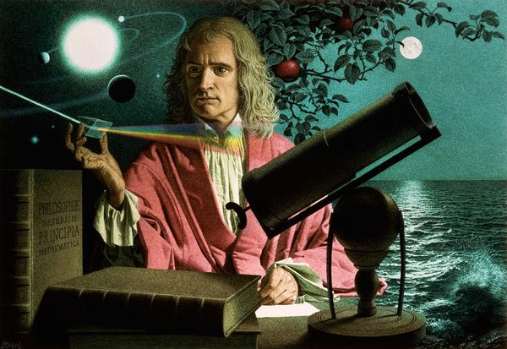
Who is responsible for our understanding of this science phenomena?
Extend/elaborate
Video 1
Video 2
Video 3
Video 4
Video 5
Video 6
Newton’s Second
Tie either the NASA clips or the Making Science Easy to your load bearing cars.

Slide 31
Other Extend/elaborate Ideas…..
Page 45 in teacher’s manual
Literacy connection:
Read: Motion and Design: “Learning from Butterflies”
Make the connection between article and what we did with our weight bearing vehicles.

Slide 32
Evaluate
Look over your chart…
Use the rubric in your packet.
Do you need to improve your Claims/Evidence/Reasoning?

Slide 33
Looking at the practices – Lesson 4
Practice 1 – Asking questions and defining problems
Practice 2 – Developing and using models
Practice 3 – Planning and carrying out investigations
Practice 4 – Analyzing and interpreting data
Practice 5 – Using mathematics and computational thinking
Practice 6 – Constructing explanations and designing solutions
Practice 7 – Engaging in argument from evidence
Practice 8 – Obtaining, evaluating, and communicating information

Slide 34
Essential Standards - Lesson 4
5.P.1.1
Explain how factors such as gravity, friction, and change in mass affect the motion of objects.
5.P.1.4
Predict the effect of a given force or change in the mass on the motion of an object.

Slide 35
Make- up session
Thursday, January 8, 2015 3:30 Classroom D
More than 1 session to make up: homework is due on January 8

Slide 36
Agenda
Make up session information
Looking at Force and Motion Learning Targets and STC kit
Add learning targets and STC lessons
Lesson 5 – Design to Meet Requirements

Slide 37
5th Grade Science Standards, Lesson Correlations
Forces and Motion
Essential Standards | Clarifying Objectives | Specific Content | Learning Targets | Lessons/Resources that Support
5.P.1 Understand force, motion and the relationship between them. | 5.P.1.1 Explain how factors such as gravity, friction, and change in mass affect the motion of objects. | Acceleration due to gravity How friction impacts and objects motion Mass of objects and how it impacts motion
 | 5.P.1.2 Infer the motion of objects in terms of how far they travel in a certain amount of time and the direction in which they travel. | Speed of moving objects Velocity = speed it is moving and the direction it is moving in.
 | 5.P.1.3 Illustrate the motion of an object using a graph to show a change in position over time. | Graphing speed of an object. Show on the graph: Acceleration Constant motion No motion Moving backwards
 | 5.P.1.4 Predict the effect of a given force or change in the mass on the motion of an object. | Balanced/unbalanced forces Large force on an object at a given mass will have greater acceleration than a smaller force on the same object. An object with a large mass needs a greater force to accelerate than an object of a smaller mass.

Slide 38
Lesson 5, page 51 NC Science Essential Standards Correlation
5.P.1.1
Explain how factors such as gravity, friction, and change in mass affect the motion of objects.
5.P.1.2
Infer the motion of objects in terms of how far they travel in a certain amount of
time and the direction in which they travel.
5.P.1.4
Predict the effect of a given force or change in the mass on the motion of an object.

Slide 39
Set Up
Rebuild the car – Page 21 (tm)
Student book – page 5
Set up the Falling Weight System
TM - Pages 36-37
Student pgs. 14-15
Page 32

Slide 40
Engage
What made our Vehicle move slowly What made our vehicle move fast

Slide 41
Engineering and Design process

Slide 42
Engage The design challenge
You are part of a famous engineering design team. Your team has been hired by “Out-of-This-World Vehicles,” a company that specializes in designing space exploration vehicles. Your team must design and build a lunar vehicle that will move slowly on wheels across the lunar surface while being pulled by a rope. The design requirements are the following.:
Start with the standard vehicle. Add building pieces to make your design unique. Be creative.
Your vehicle must be able to carry large lunar rocks (represented by blocks).
Your vehicle must move across your work space in 4 to 6 seconds while being pulled by a rope.
Deadline: You will have 30 minutes to complete the challenge.
Good luck!

Slide 43
evaluate
Designing and Planning:
Before building your vehicle, how did your group prepare?
Building:
Did you experience any problems as you were building your vehicle? How did you solve them?
Testing:
How did you test your vehicle to determine whether it met the requirements? How did your vehicle move?
Evaluating:
Did you change anything about your vehicle or the falling weight system after you tested it? What change did you make? Why did you make this change?

Slide 44
What practices?
Practice 1 – Asking questions and defining problems
Practice 2 – Developing and using models
Practice 3 – Planning and carrying out investigations
Practice 4 – Analyzing and interpreting data
Practice 5 – Using mathematics and computational thinking
Practice 6 – Constructing explanations and designing solutions
Practice 7 – Engaging in argument from evidence
Practice 8 – Obtaining, evaluating, and communicating information

Slide 45
Workshop Evaluation
Please complete by Friday, December 12, online.
Thank you for all that you do!!

Slide 46
Force and Motion - Extended
Agenda:
Walking Directions – integrated with Math
Gravity on a Roll (with modification)
Connecting the lessons to our Essential Standards/objectives/learning targets

Slide 47
Walking Directions
Math Standards
5.OA.B.3 Generate two numerical patterns using two given rules. Identify apparent relationships between corresponding terms. Form ordered pairs consisting of corresponding terms from the two patterns, and graph the ordered pairs on a coordinate plane.
Science Essential Standards
5.P.1.3
Illustrate the motion of an object using a graph to show a change in position over time.

Slide 48
Walking Directions Examining how graphs represent data and “tell stories”

Slide 49
Representations and Models
Important for
making predictions and
solving problems
in a variety of mathematical and scientific contexts.

Slide 51
What can we measure to gather evidence of these observations?
How can we represent this evidence?

Slide 52
Small group task
Act out your directions and gather data.
Represent the data in your notebook on a t-chart and a coordinate graph.
Make two posters:
1) directions and
2) graph (X-scale by 1’s, Y-scale by 2’s)
Be ready in 20 minutes.

Slide 53
Comparing Representations
What do you notice about the posted graphs?
By looking at a graph, what can you say about the directions?

Slide 54
What does this graph tell you about my morning walk?

Slide 55
Diving with gravity
What are the attributes of Walking Directions that encourage students to construct arguments, reason, analyze and interpret data?

Slide 56
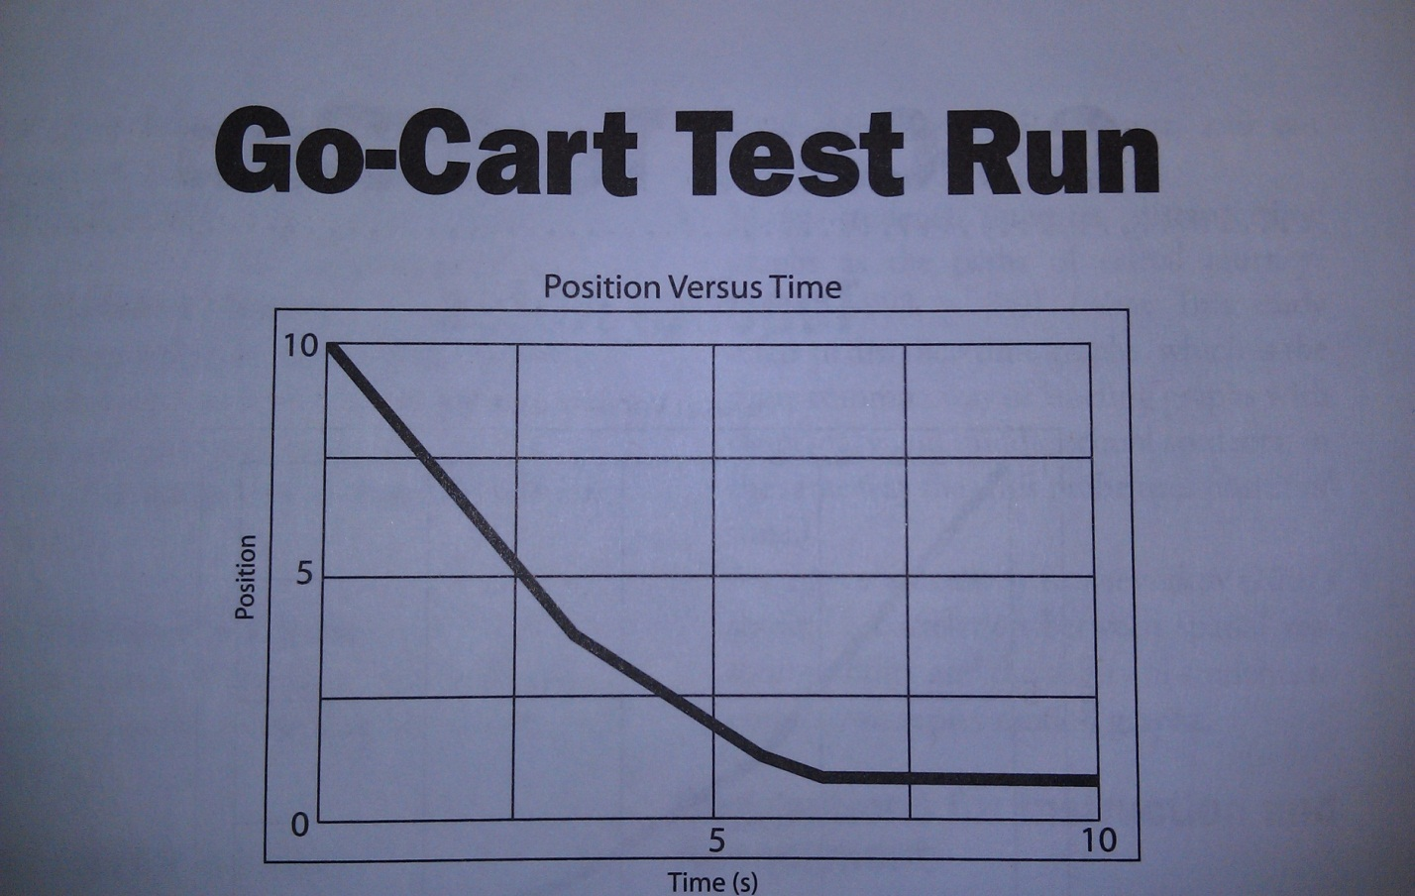
How can we describe motion and changes in motion?
Go-Cart Test Run
Uncovering Student Ideas in Physical Science
by Page Keely and Rand Harrington
Pg. 30-34

Slide 57
1) Each table will need:
Marbles
Meter stick
2) Mark a one-meter distance on your table with tape

Slide 58
Roll the marbles the one-meter distance
Record (draw, describe and measure):
How long does it take one marble to travel one meter?
What measurements describe the marble’s movement
Can you get a marble to move 1 m/sec?

Slide 59
Continue to explore with the marble.
Roll the marble over different surfaces.
Change the marble’s direction and speed.
Change the marble’s direction while holding the speed constant.

Slide 60
Speed
how fast something is going
measured by the distance traveled divided by the time to travel that distance
Instantaneous Speed
speed at a particular instant
Average Speed
a calculated speed, comparing a set distance over a set time

Slide 61
Velocity:
how fast something is going, including the direction it’s going.
Acceleration:
any change in speed and/or direction and the time it took for the change.

Slide 62
Cliff diving
Put together the dive photo.
Mark the center of gravity on the diver (navel).
Part 1
Measure the distance traveled between each photograph in cm. (1cm=1 foot)
Record that information on chart.
Graph that data on the graph provided.
Part 2
Measure and record the total distance (from 0) for each photo.
Graph this data using a different color.

Slide 63
Connecting our Learning
What can you tell about the diver’s motion from the photograph?
Your graph of the distance between each exposure shows a trend. What does this tell you about the distance the diver falls?
How is the total distance graph different from the graph about distance between exposures?
What does the total distance fallen graph tell you about the diver’s motion?
What is responsible for this motion?
What does this tell you about gravity and acceleration?
Both graphs tell you the diver’s speed is increasing. How does each one do it differently?

Slide 64
What inference can you make about acceleration by listening to the washers as they hit the floor?
How does this demonstration provide evidence for “acceleration due to gravity?”
Historically, who is known for studying this phenomenon?

Slide 65
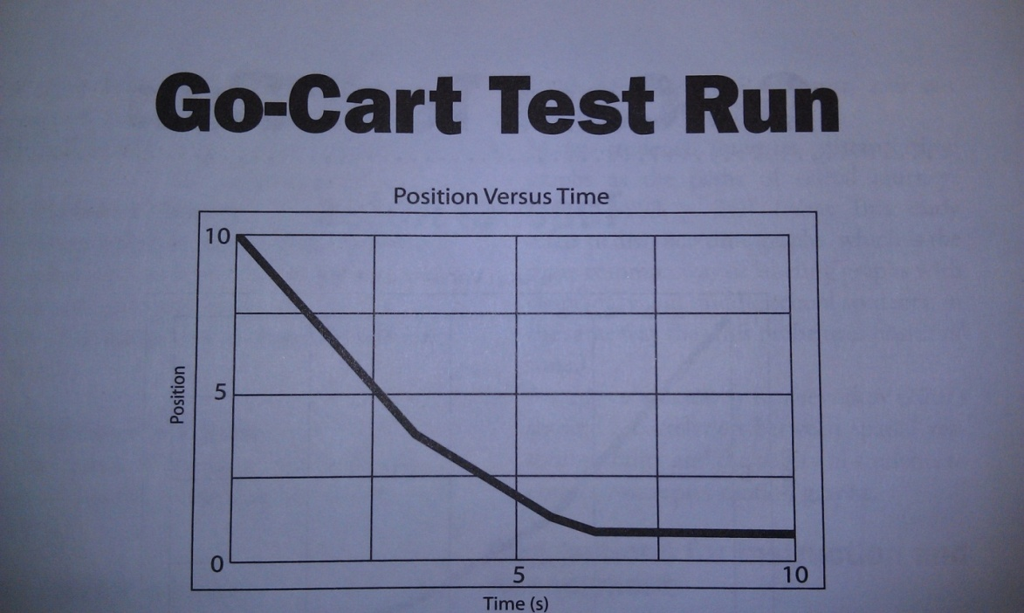
Jim and Karen have built a go-cart. They take their go-cart for a test run and graph its motion. Their graph is shown above.
They show the graph to their friends. This is what their friends say:
Bill: “Wow, that was a steep hill! You must have been going very fast at the bottom.”
Patti: “I think you were going fast at first, but then you slowed down at the end.”
Kari: “I think you must have hit something along the way and come to a full stop.”
Mort: “It looks like you were going downhill and then the road flattened out.”
Position
Time (s)

Slide 66
Force and Motion - extended
5.P.1.1 Explain how factors such as gravity, friction, and change in mass affect the motion of objects. | Acceleration due to gravity How friction impacts and objects motion Mass of objects and how it impacts motion | I can explain how objects accelerate due to the force of gravity. | Cliff Divers
5.P.1.2 Infer the motion of objects in terms of how far they travel in a certain amount of time and the direction in which they travel. | Speed of moving objects Velocity = speed it is moving and the direction it is moving in. | I know how to determine the speed of moving objects. I understand that velocity is the speed and the direction an object is moving. | Gravity on a Roll Gravity on a Roll
5.P.1.3 Illustrate the motion of an object using a graph to show a change in position over time. | Graphing speed of an object. Show on the graph: Acceleration Constant motion No motion Moving backwards | On a graph I can point out when a object accelerates. On a graph I can point out when an object is increasing or slowing in speed. I can point out a change of velocity on a graph. | Walking Directions

