Slide 1
Fifth Grade Foss PD, Pt 2
October 22, 2014

Slide 2
AGENDA
Checking in
Condensation – Foss Investigation 3.1
The Making of a Cloud
Cloud Identification
Lunch 11:30 – 12:30
Cloud Citizen science – Ceres Cloud project, nasa
Jet stream
El Nino/la nina

Slide 3
Checking in….
Foss questions?
Moodle
Memta - http://www.sendmyteacher.com/ due October 31
Ncsta – November 6 – 7, Winston-salem conference center
Other news?

Slide 4
A Cloud is born…pre set up
Skip 4 or 5 pages and start a new page (we’ll be doing this activity later).
Question: How does a cloud form?
Use blue card to set up A Cloud is Born.
We’ll be making observations every half hour, but make your first observation now!!!
Who will be our timer?????

Slide 5
Working conditions
Choose to be present.
Bring your best self to the work.
Model behavior to inspire others.
Be an active listener.
Assume positive intent.
Be part of the discussion.
The group loses when you silence yourself.
Learning is a process, not an event.
Be open to outcomes not attached to them.
Accept not fully know for now.
The process continues as long as you choose to engage in learning.

Slide 6
Investigation 3.1 - condensation
Engage
Where did the water come from?

Slide 7
Two cups of water
Explore
Get two cups of water
250 mL each
one blue, one green
Make some observations - record
Question: What causes condensation to form?
Design an investigation to try to get more information about the liquid that forms on the outside of the cup.

Slide 8
Claims and evidences
Explain
When you have finished your investigation and recorded your observations, make a claims and evidence table to answer the question based on what you did for your investigation.
claim evidence reasoning
What do you know?
How do you
know?
Why does your evidence support your claim?

Slide 9
Adding on - Reasoning
Explain
Why does your evidence support your claim?
Claims, Evidence and Reasoning (CER model)
An explanation consists of:
A claim that answers the question
Evidence from students' data
Reasoning that involves a "rule" or scientific principle that describes why the evidence supports the claim

Slide 10
Example
Is air matter?
Air is matter (claim). We found that the weight of the ball increases each time we pumped more air into it (evidence). This shows that air has weight, one of the characteristics of matter (reasoning).
The explanation could be made more complete by including evidence and reasoning related to air taking up space.

Slide 11
Where does condensation occur?
Explain
Discuss
Key vocabulary: water vapor, condensation, condense
Talk about condensation. Think about other times and places you have seen condensation. Try to figure out where condensation occurs and where it doesn’t.
Is there anything about the conditions and places where condensation takes place?

Slide 12
The condensation chamber!!!!!!
Materials:
250 mL tub with cup snapped on.
Set up conditions to show condensation within the chamber.
Record your observations on the sheet. Write what you saw happening using the vocabulary words: water vapor, condensation, condense
Where did the water condense? Why?
Where did the water that condensed on the sides of the cup come from?

Slide 13
Ice and water system
Use page 16 to help set up the ice and water system.
Question: What do you think might happen to the ice and water system?
Formulate a hypothesis of your thoughts and don’t forget to explain why you think what you do.
Set up the system and make observations about what is happening.

Slide 14
Let’s make it colder and see what happens.
Thermometer in the ice, record the temperature.
Add 2 spoons of rock salt, stir. Take the temperature again and record.
After a few minutes lift the ice cup….observe what you see.
Can you add to your claims, evidence and reasoning chart? (use vocab)
Question: What causes condensation to form?

Slide 15
Back to the probe
Evaluate
Where did the water come fr

Slide 16
A cloud is born
What kind of cloud experiences have you had?
Question: How does a cloud form?
Write your answer to the question, using water cycle vocabulary:
Use detail to explain how you think clouds for and explain why it happens as you says it does.
Let’s make a cloud!!!!

Slide 17
Looking at our clouds….
What happens when you push down on the balloon?
How about what happens when you pull up on the balloon (not too hard)?
Why does this happen?
On what kind of particles is the water vapor condensing on?

Slide 18
What’s happening to the salt?
How did the salt grains change?
Where did the water come from?
How is our observation like what happens when clouds form in the atmosphere?
How are our observations different?

Slide 19
Condensation nuclei
What are cloud condensation nuclei?
Cloud condensation nuclei (CCN) are aerosols that act as the initial sites for condensation of water vapor into cloud droplets or cloud ice particles. Virtually all cloud droplets or ice particles originate around some sort condensation nuclei which tend to "attract" water.

Slide 20
Water vapor has to condensate onto something.
Let’s look back at where we’ve seen condensation forming.
To have condensation, there has to be something for the water vapor to “stick to.”
Condensation Nuclei:
small particles in air created from/by:
dust
volcanoes
factory smoke
forest fires
ocean salt
sulfate particles from phytoplankton in ocean

Slide 21
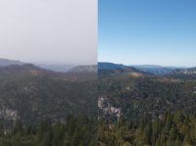
Looking at the aerosols in the air
Important for condensation nuclei to make clouds, but have an impact on sky visibility.
The amount of aerosols in the atmosphere affects our sky conditions.
We can’t normally see aerosols, but can see the impact by observing and categorizing the sky color.

Slide 22
Learning the Colors of the Sky
You need five cups.
Measure about 1.5 inches of water into each cup (find the volume and make it the same).
You’ll be adding milk to four of the cups.
Look at the chart to find out how much milk to put into each cup.
Each cup sits on a blue circle. Make observations at each cup and look at the color of blue as you look straight down into the cup. This is the sky color, if you look from the side, you see the visibility.
Record your observations!

Slide 23
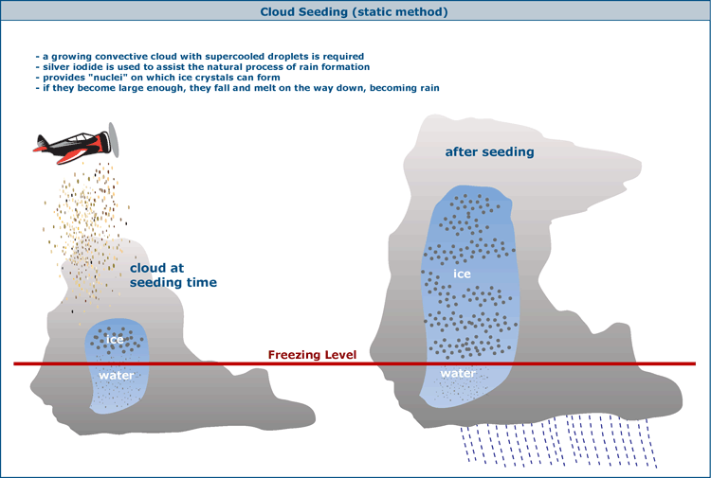
Cloud Seeding
In areas of drought, cloud seeding is sometimes used to bring about rain.
Even dry areas have moisture in the air.
How do you think it works?

Slide 24
Cloud identification
Sky Cloud, by Thomas Locker
Cloud sort
Cloud Name | Characteristics of the Clouds

Slide 25
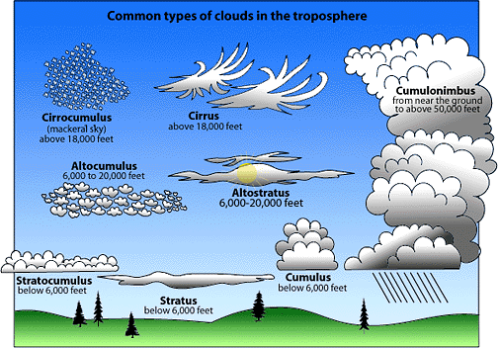
Identifying Characteristics
Height
Low level
Mid level: alto
High level: cirro
Shape
Puffy: cumulous
Sheet or layers: stratus
Whispy, mane like: cirrus
Rain
Nimbus

Slide 26
Cloud Name | Level | Drawing | Weather Associated

Slide 27
CLOUD TYPE ▲ | ASSOCIATED WEATHER
Stratus | May drizzle-may be associated with low visibility.
Stratocumulus | May drizzle-may be associated with low visibility.
Nimbostratus | Heavy continuous rain or snow.
Cumulusnimbus | Thunderstorms, lightening, showers of rain, snow or hail.
Cumulus | Usually none, unless large formations that have been associated with showers of rain and snow begin to react.
Cirrus | None
Altostratus | Light rain that may or may not reach the ground.

Slide 28
Cloud game
Coodie catchers
Cloud Clues

Slide 29
Ideas for student cloud projects:
http://scool.larc.nasa.gov/cgi-bin/view_lessonplan.cgi?id=7
Animoto Projects
Cloud Journals

Slide 30
S’cool Data collection

Slide 31
Jet stream
Know | Learn | Wonder

Slide 32
Air masses
Where do the following air masses come from?
Continental polar cP Artic polar aP Maritime polar mP
maritine tropical mT continental tropical cT

Slide 33
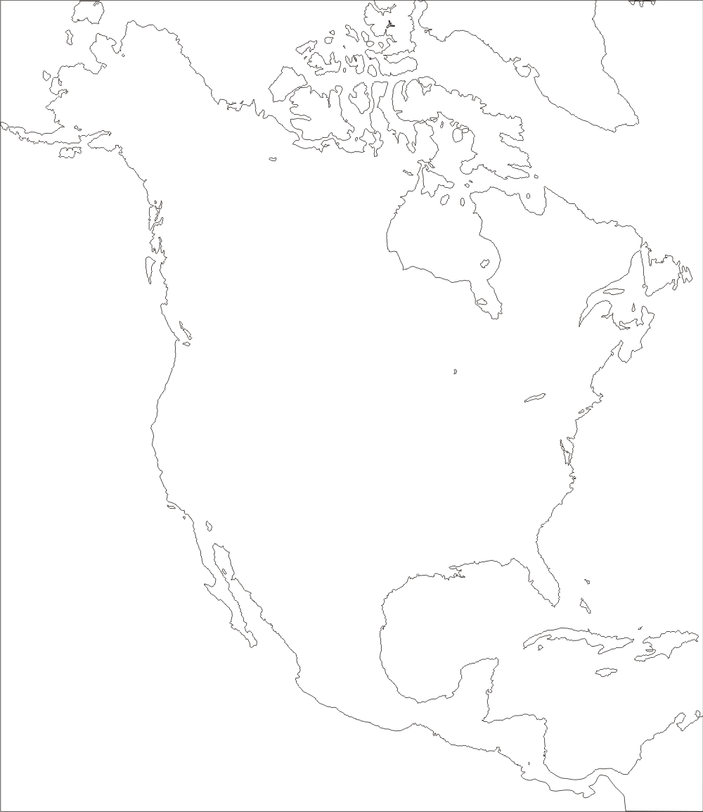
mP
cA
mP
cP
mT
cT
mT

Slide 35
Use you KLW chart
The Effects of Jet Stream on Climate
Record what you learn from the vide and what you are still wondering.
http://www.cpalms.org/Public/PreviewResourceLesson/Preview/46069

Slide 36
Read What is a Jet Stream?
Discuss:
1. What is the jet stream?
2. Where are the jet streams?
3. What influences the velocity (speed) of the jet stream?
4. What do jet streams have to do with cold and warm air?
5. What can happen with warmer jet streams?
6. How can jet streams impact weather?

Slide 37
Jet Steam Changes throughout the year
Use the two blank USA maps and draw one winter jet stream and one summer jet stream.
Looking at conditions around the jet stream.
Label the weather conditions around your winter jet stream.

Slide 38
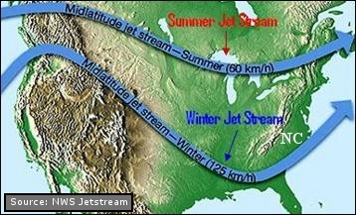
What do you wonder now?

Slide 39
El Nino and La Nina

Slide 40
El Nino
El Nino is characterized by unusually warm ocean surface temperatures in the Pacific.
Brainstorm ideas of the impact of these warm temperatures on climate, think about:
Weather
Marine life
Global weather based disasters

Slide 41
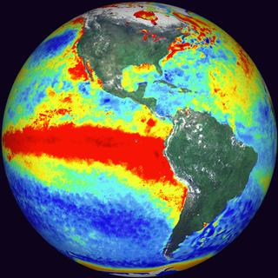
National Geographic video
El Nino – Ocean Water Gets Warmer in the Pacific around the Equator.
What is the impact on weather in the United States during an El Nino year?

Slide 42
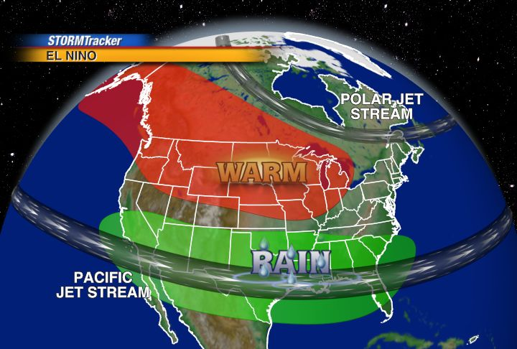
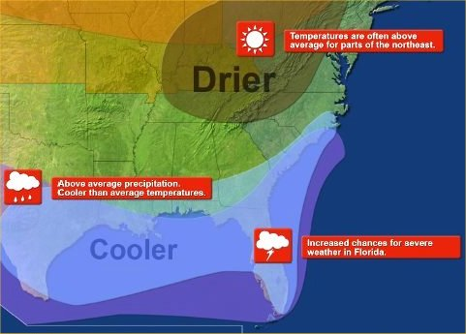
El Nino Map

Slide 43
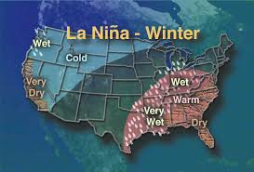
La Nina
What is La Nina’s impact on weather in the United States?
La Nina Map

Slide 44
What are the benefits of accurately predicting an El Nino or La Nina?
Weather Bug

Slide 45
Next Meeting
Wednesday, October 29 3:30-5:30
Please complete the feedback sheet – Have a great week!

